Slide 1
“THEORY OF AUTOMATA”
Regular languages

Slide 2
Summary
Example of prefixes of a language, Theorem: pref(Q in R) is regular, proof, example, Decidablity, deciding whether two languages are regular or not ?, method 1, example, method 2, example
Example
Let Q and R be expressed by ab*a and (ba)* respectively i.e. Q={aa,aba,abba, …} and R={Λ, ba, baba, bababa, …}. aba is the only word in Q which can make a word in R, because the words in R don’t contain the double letter. Thus pref(Q in R) = {b, bab, babab, …}, which can be expressed by b(ab)* or (ba)*b.

Slide 3

Remark
It may be noted that the language R cannot be factorized with the help of language Pref(Q in R) i.e.
Pref(Q in R)Q is not equal to R in general. However the following theorem shows that the language pref(Q in R) is regular if R is regular, no matter whether the language Q is regular or not.

Slide 4
Theorem
Statement
If R is regular language and Q is any language (regular/ nonregular), then Pref(Q in R) is regular.

Slide 5
Proof
Since R is regular there exists an FA that accepts this language. Choose a state, say, s of this FA and see whether this state can trace out a path ending up in a final state while running words from Q. If this state traces out a path ending up in a final state for any of the words of Q, mark this state with certain colour.
Repeat this process for remaining states of the machine. If at least one state of this machine is marked then it can be shown that the language Pref(Q in R) is non-empty. Now build a new FA with some marked states by considering the initial state that of original FA and final states which are marked.
The machine, thus obtained accepts exactly the language Pref(Q in R). Thus Pref(Q in R) being accepted by an FA is regular.

Slide 6
Remark
There is a problem in deciding whether a state of FA should be marked or not when the language Q is infinite.
This proof just gives non constructive method to prove that Pref(Q in R) is regular.

Slide 7
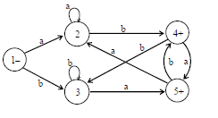
Example
Consider the languages Q={aba, abb} and R = {w ≥ {a,b}* : length(w) 2, w ends in either ab or ba}, where R may be accepted by the following FA
It can be observed that the string aba from Q make the words of R and hence the states 1,2,3,4 and 5 can easily be marked. Thus from the given FA, making the states 1, 2 and 3 to be final as well, the resulting
FA will accept the language pref(Q in R). Moreover it can be observed that pref(Q in R) can be expressed by (a+b)*, which isthe RE corresponding to the resulting FA as well.

Slide 8
Determining whether the two languages are equivalent or not ?
If L1 and L2 are two regular languages, then they can be expressed by FAs. As shown earlier, L₁ ^{c} , L₂ ^{c} , L₁ L₂ , L₁ U L₂ are regular languages and the methods have already been developed to build their corresponding FAs. It can be observed that (L₁ L₂^{c} ) U ( L₁^{c} L₂ ) is regular language that accepts the words which are in L₁ but not in L₂ or else in L₂ but not in L₁ .
The corresponding FA cannot accept any word which is in both L₁ and L₂ i.e. if L₁ and L₂ are equivalent, then this FA accepts not even null string. Following are the methods that determine whether a given FA accepts any words.
U
U
U

Slide 9
Method 1
For FA corresponding to (L₁ L₂ ^{c} ) U( L₁ ^{c} L₂ ), the regular expression can be determined that defines the language accepted by this FA. From that regular expression one can determine whether this regular expression defines any word or not?
Following are the steps to be followed
Remove all *s from the regular expression.
Separate the right part of + and the plus itself.
The regular expression thus obtained if contains atleast one word then the language is not empty otherwise the language is empty.
U
U

Slide 10
Example
U
For (a+Λ)(a*b+ba*)(a*+Λ)* to be the regular expression of (L₁ L₂^{c} )
U ( L₁^{c} L₂ ), it is required to find whether this language accepts any string or not?
After removing all *s the RE will be (a+Λ)(ab+ba)(a+Λ)
After separating the right part from + and the + itself the RE will be aaba
As this language contains at least aaba as its word, so this language is not empty.
U

Slide 11



Remark
Sometimes, while determining regular expression for a given FA, it is impossible to write its regular expression e.g.
FA₁
FA₂
FA₃

Slide 12
Method 2
To examine whether a certain FA accepts any words, it is required to seek the paths from initial to final state.
But in large FA with thousnads of states and millions of directed edges, without an effective procedure it is impossible to find a path from initial to final state. Following are the steps of this procedure
Mark the initial state.
For every marked state follow each edge that leads out of it and marked the concatenating states and delete these edges.
Repeat step 2 until no new state is marked.
If any of the final states are marked then the FA accepts some word, otherwise not.

Slide 13
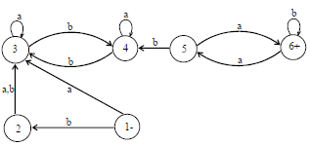
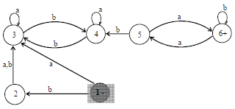
Example
Suppose it is required to test the FA, which is given below, whether it accepts any string or not? Applying method 2 as

Slide 14
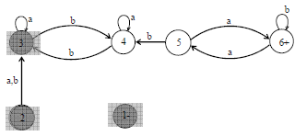
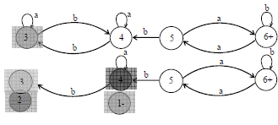


Slide 15
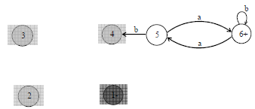
This FA accepts no string as after applying method 2, the final state is not marked.

Slide 16
Summary
Deciding whether two languages are equivalent or not, example, deciding whether an FA accept any string or not, method 3, examples, finiteness of a language

Slide 17
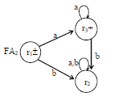

Example
Consider two languages L₁ and L₂, expressed by the REs r₁=a* and r₂=Λ+aa* respectively. To determine whether L₁ and L₂ are equivalent, let the corresponding FAs be
As discussed earlier, the FA corresponding to the language
(L₁ L₂^{c}) U (L₁^{c} L₂) helps in this regard i.e. if this
FA accepts any word then L₁ and L₂ are not equivalent other wise L₁ and L₂ are equivalent.
U
U

Slide 18
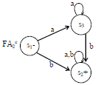

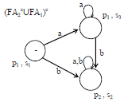
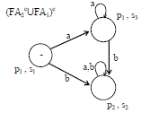
Following are the FAs corresponding to L₁^{c} and L₂^{c}
FAs corresponding to (FA₁^{c} U FA₂)^{c} and (FA₂^{c} U FA₁)^{c} may be as follows

Slide 19
Both the FAs have no final state, so these FAs accept nothing. This implies that their union will not also accept any string. Hence FA corresponding to the language (L₁ L₂^{c}) U (L₁^{c} L₂) accepts nothing. Thus both the languages are equivalent.
U
U

Slide 20
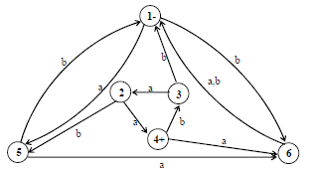
Example
Following is an FA, for which it is required to decide whether it accepts any string or not?
Using steps discussed in method 2, the following FA can be checked whether it accepts any word or not.

Slide 21
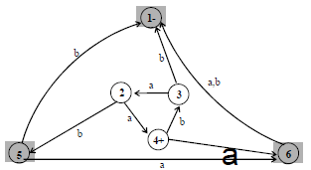
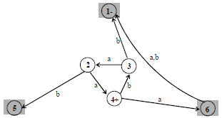

Slide 22
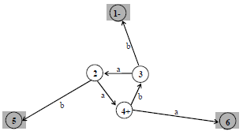
As no final state of the FA is marked, so the given FA accepts no word.

Slide 23
Method 3
If the FA has N states, then test the words of length less than N. If no word is accepted by this FA, then it will accept no word.
Note: It is to be noted that all the methods discussed above, to determine whether an FA accepts certain word, are effective procedures.

Slide 24

Example
Consider the following FA. To determine whether this FA accepts some word, all the strings of length less than 4 (i.e. less than the number of states of this FA) are to be tested
It can be observed that none of the strings L, a, b, aa, ab, ba, bb, aaa, aab, aba, abb, baa, bab, bba, bbb, is accepted by this FA.
Thus the given FA cannot accept any word.

Slide 25
Observation
To find whether a regular expression defines an infinite language or not? The following possibilities are required to be checked.
If a regular expression contains * then it may define an infinite language, with the exception Λ* as Λ* = Λ e.g.
(Λ+aΛ*)(Λ*+Λ)* defines finite language. While (Λ*+aΛ*)* (Λ*+Λ)* defines an infinite language.
There are so many ways to decide whether an FA accepts a finite language or an infinite. Following is a theorem in this regard

Slide 26
Theorem
Let F be an FA having N states
If F accepts a word w s.t. N ≤ length(w) < 2N
then F accepts infinite language.
If F accepts an infinite language then there are some words w s.t. N  length(w) < 2N
The first part can be proved, using the pumping lemma version II.

Slide 27
Remark
There is an effective procedure to decide whether an FA accepts finite or infinite language. For a machine with N number of states, the total number of strings to be tested, defined over an alphabet of m letters, is m^{N} +m^{N+1}+ m^{N+2} +… +m^{2N-1}. After testing all these strings on the machine,.
If any is accepted then the machine accepts infinite language other wise not. e.g. for machine of three states and alphabet of two letters, 2 ³ +2 ⁴ +2 ⁵ = 56 strings are to be tested.

Slide 29
This FA accepts no string as after applying method 2, the final state is not marked.

Slide 30
Summary
Example of Ambiguous Grammar, Example of Unambiguous Grammer (PALINDROME), Total Language treewith examples (Finite and infinite trees), Regular Grammar, FA to CFG, Semi word and Word, Theorem, Defining Regular Grammar, Method to build TG for Regular Grammar
Example
Consider the following CFG
S aS | bS | aaS | Λ
It can be observed that the word aaa can be derived from more than one production trees. Thus, the above CFG is ambiguous. This ambiguity can be removed by removing the production S A aaS

Slide 31
Example
Consider the CFG of the language PALINDROME
S aSa|bSb|a|b|Λ
It may be noted that this CFG is unambiguous as all the words of the language PALINDROME can only be generated by a unique production tree.
It may be noted that if the production S A aaSaa is added to the given CFG, the CFG thus obtained will be no more unambiguous.

Slide 32
Total language tree
For a given CFG, a tree with the start symbol S as its root and whose nodes are working strings of terminals and non-terminals. The descendants of each node are all possible results of applying every production to the working string.
This tree is called total language tree.
Example
Consider the following CFG
S aa|bX|aXX
X ab|b

Slide 33
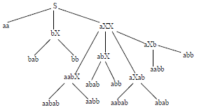
then the total language tree for the given CFG may be
It may be observed from the above total language tree that dropping the repeated words, the language generated by the given CFG is {aa, bab, bb, aabab, aabb, abab, abb}

Slide 34

Example
Consider the following CFG
S X|b, X aX
then following will be the total language tree of the above CFG
Note: It is to be
noted that the
only word in
this language
is b.

Slide 35
Regular Grammar
All regular languages can be generated by CFGs. Some nonregular languages can be generated by CFGs but not all possible languages can be generated by CFG, e.g. the CFG S aSb|ab generates the language {a^{n}b^{n}:n=1,2,3, …}, which is nonregular.
Note: It is to be noted that for every FA, there exists a CFG that generates the language accepted by this FA.

Slide 36

Example
Consider the language L expressed by (a+b)*aa(a+b)* i.e.the language of strings, defined over A ={a,b}, containing aa. To construct the CFG corresponding to L, consider the FA accepting L, as follows
CFG corresponding to the above FA may be
S bS|aA
A aB|bS
B aB|bB|Λ
It may be noted that the number of terminals in above CFG is equal to the number of states of corresponding FA where the nonterminal S corresponds to the initial state and each transition defines a production.

Slide 37
Semiword
A semiword is a string of terminals (may be none) concatenated with exactly one nonterminal on the right i.e. a
semiword, in general, is of the following form
(terminal)(terminal)… (terminal)(nonterminal)
word
A word is a string of terminals. Λ is also a word.

Slide 38
Theorem
If every production in a CFG is one of the following forms
Nonterminal semiword
Nonterminal word
then the language generated by that CFG is regular.

Slide 39
Regular grammar
Definition
A CFG is said to be a regular grammar if it generates the regular language i.e. a CFG is said to be a regular grammar in which each production is one of the two forms
Nonterminal semiword
Nonterminal word
Examples
The CFG S aaS|bbS|L is a regular grammar. It may be observed that the above CFG generates the language of strings expressed by the RE (aa+bb)*.
The CFG S aA|bB, A aS|a, B bS|b is a regular grammar. It may be observed that the above CFG generates the language of strings expressed by RE (aa+bb)+.

Slide 40
TG for Regular Grammar
For every regular grammar there exists a TG corresponding to the regular grammar.
Following is the method to build a TG from the given regular grammar
Define the states, of the required TG, equal in number to that of nonterminals of the given regular grammar. An additional state is also defined to be the final state. The initial state should correspond to the nonterminal S.
For every production of the given regular grammar, there are two possibilities for the transitions of the required TG

Slide 41
If the production is of the form nonterminal semiword, then transition of the required TG would start from the state corresponding to the nonterminal on the left side of the production and would end in the state corresponding to the nonterminal on the right side of the production, labeled by string of terminals in semiword.
If the production is of the form nonterminal word, then transition of the TG would start from the state corresponding to nonterminal on the left side of the production and would end on the final state of the TG, labeled by the word.

Slide 42

Example
Consider the following CFG
S aaS|bbS| Λ
The TG accepting the language generated by the above CFG is given below
The corresponding RE may be (aa+bb)*.

Slide 43
LINK
en.wikipedia.org/wiki/Regular_language
minimalism.linguistics.arizona.edu/~langendoen/LING501/LING501regular.htm

